Slide 1

Programmatic is not just for performance, it rocks for branding as well
Max Makarenko
Google Ukraine

Slide 2



Challenge: marketers use on average
5 different technologies to run a single campaign
One campaign, one goal,
one consumer
Source: Navigating the Road to the Consolidated Buying Platform, Forrester Consulting commissioned by Google, 2013; The Future of Digital Marketing, Illuminas, May 2013

Slide 3









Bring everything together in real time with relevant data
Creating
Buying
Managing
Measuring

Slide 4
3 main reasons why programmatic buying
can save money
Optimized visibility and better control
100% targeted
to the right audience
One joint reach
and frequency

Slide 5

Use powerful tools to watch over your media buys
  Visibility
Makes sure ads are actually viewed
(1 sec for display, 2 sec for video)
  Brand safety
  Anti Fraud
Blocks all not safe content from buying
Automatic fraud detection, impressions and clicks filtering

Slide 6


Creative using various external signals
Owned data
Google’s data
3rd party and other sources

Slide 7








Joint reach and frequency
TrueView
on YouTube
Real-Time bidding Display & Video
Premium
inventory

Slide 8
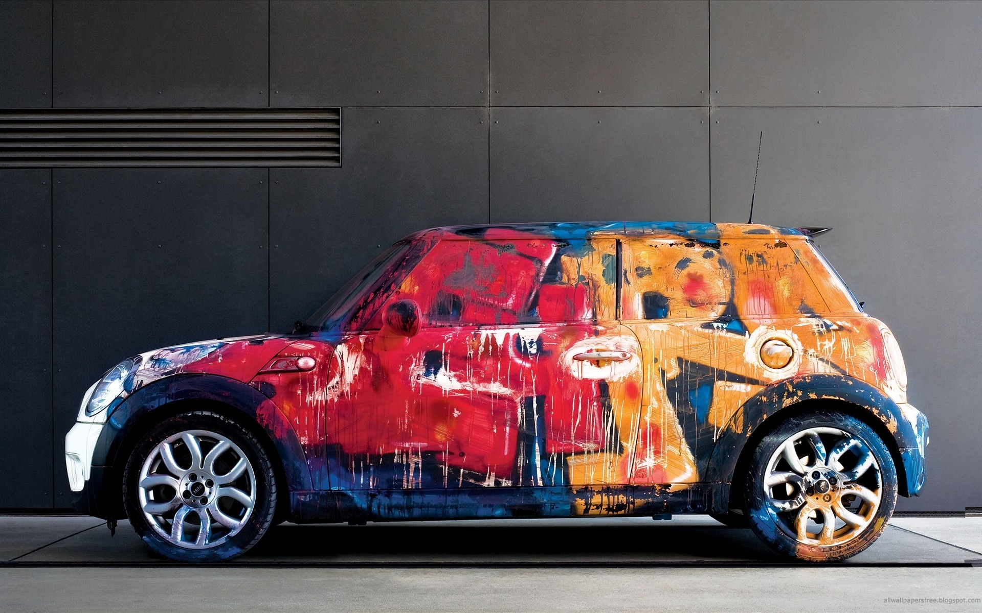

New possibilities within Creative and Video
Personalize your products
------
High impact formats
Native advertising
Video
Universal ads

Slide 9






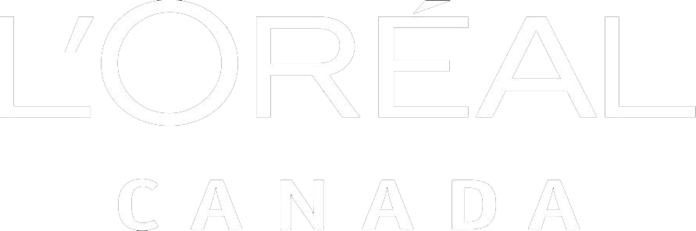

L’Oreal find beauty in programmatic buying
Awareness
Consideration
Action

Slide 10
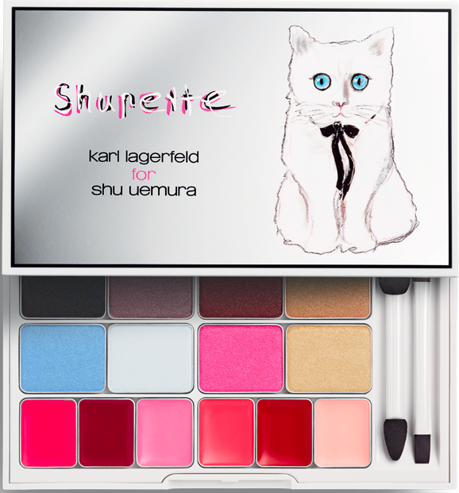
2,200%
return on ad spend (ROAS)
2X
anticipated revenue

Slide 11

Programmatic rocks for branding
Targeting precision
Visible
and safe advertising
Creativity with
no limits
Reach
and premium inventory

Slide 12
Thank you!
Max Makarenko
mmakarenko@google.com

