Slide 1
IT Education opportunities for children and young people with Autism spectrum disoder
  Anna Kosaryeva LITS | Lviv IT School

Slide 2


Slide 3
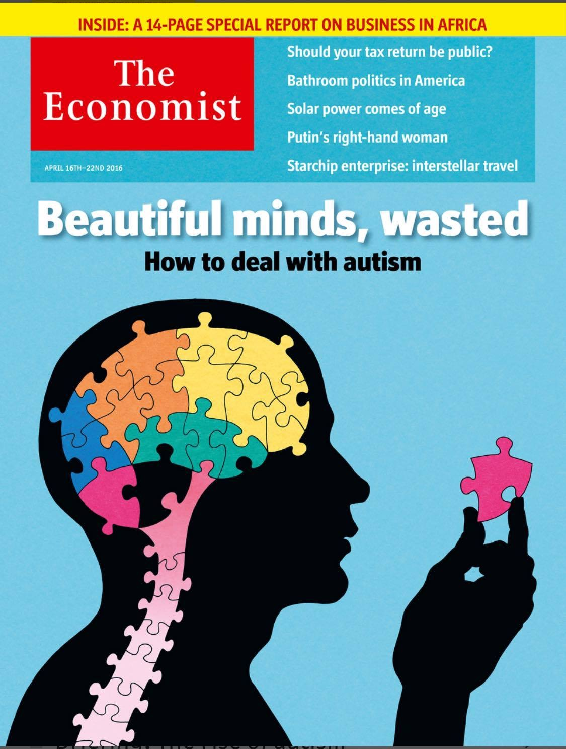

one in 68 / 38

Slide 4
what we have done

Slide 5
wHo else
Mossad
Microsoft, Vodafone, SAP, Hewlett-Packard etc.
SpecialistPeople foundation

Slide 6
To let them leave a normal life having meaningful and productive jobs in future

Slide 7
Thank you
:)

